Slide 1

2022 Local Government Candidate Diversity Survey
Electoral Management Board for Scotland (EMB) Meeting UPDATE
24 February 2022

Slide 2
Project Update
SG analysts developed, with input from EMB, EC and equality groups, proposals for a new data collection on the diversity of candidates and elected members in Scotland
Proposals were published in December - for a brief non-mandatory survey disseminated at the candidate nomination stage of the 2022 local government elections
The materials for the candidate diversity survey have now been finalised
Feedback was received recommending an approach that offered both an online and a paper option for responding.
  Returning Officers - really key role in getting information and questionnaires out to candidates. Very grateful for their support in this. Process set out on following slides

Slide 3
Approach
All candidates standing for election at the 2022 local council elections are being invited to complete a brief voluntary questionnaire on their:
  demographic characteristics,
  previous experience and
  any caring responsibilities
  Options to complete the survey on paper (returning by post) or online.
  Data protection impact assessment will be published. All responses will be kept confidential and stored securely, to be used solely for statistical and research purposes.
    A report of aggregated findings will be published by the Scottish Government following the results of the election.

Slide 4
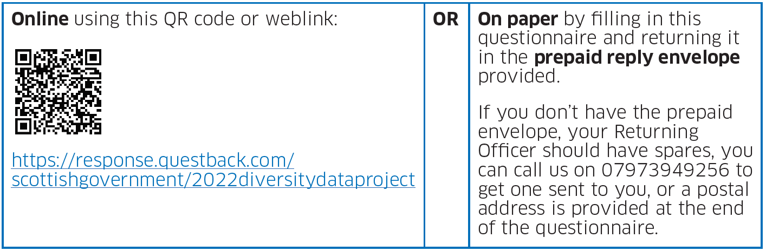
How candidates can take part
We can send you spares
The survey should take no more than 5 minutes to complete.
Returning Officers do not need to collect and send responses.

Slide 5
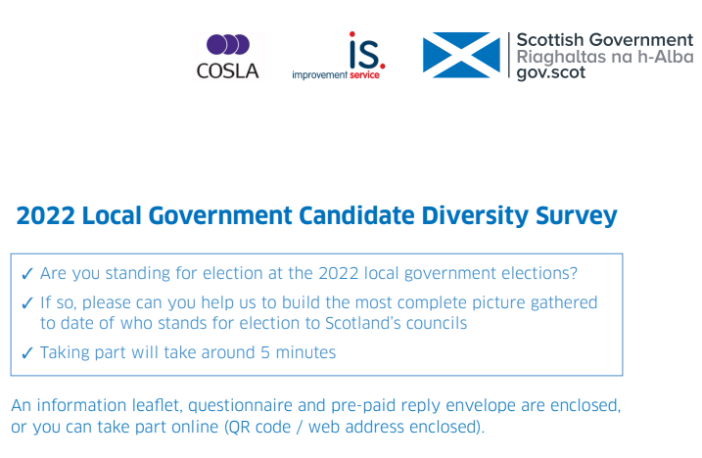
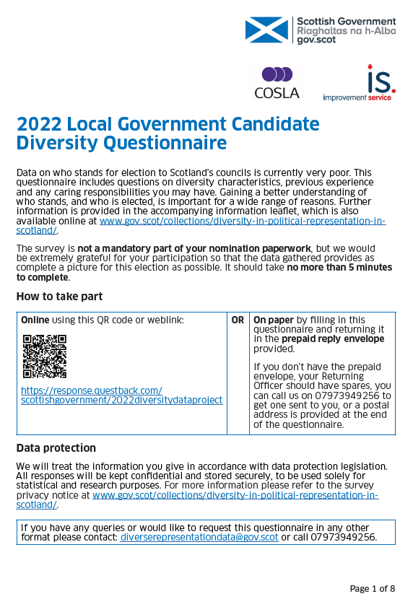

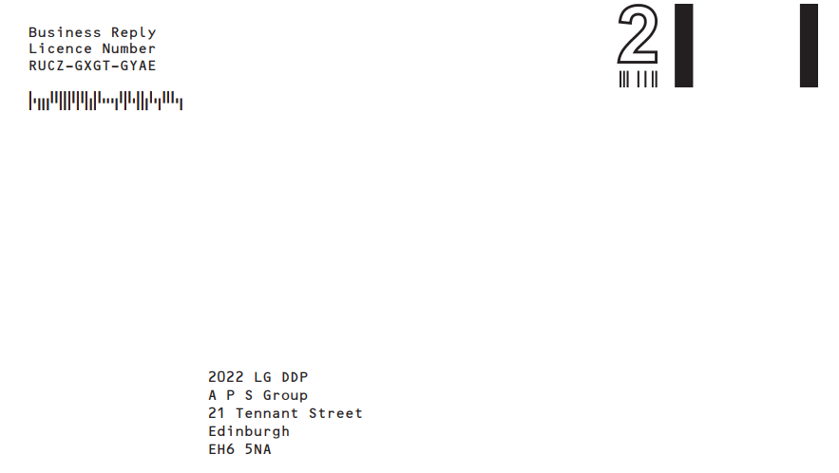
Survey ‘packs’
Returning officers will be sent batches of survey ‘packs’ by Monday 7 March based on the number of candidates they had at the 2017 elections plus a few extras.
Each pack is an A4 envelope containing:
  the paper questionnaire,
  an information leaflet about the survey,
  and a prepaid business reply envelope for returning questionnaires.
The questionnaire and information leaflets include QR codes and weblinks to take candidates to the online version of the questionnaire.

Slide 6
Returning Officers
We would be extremely grateful for the support of Returning Officers in getting these survey packs to all candidates please, either directly or via their agents, regardless of whether they are new or returning candidates, or whether they have already been serving as a councillor
The packs can be handed out at any stage that Returning Officers have contact with candidates or agents, and all information and links are available online for circulation in correspondence where possible / appropriate - https://www.gov.scot/collections/diversity-in-political-representation-in-scotland/
We haven’t set a deadline at this stage for responses. We’ll review the response rate at the end of the nomination period and potentially seek further opportunities to issue reminders at that stage before closing the survey.
We will provide all Returning Officers with a brief Q&A document in the next week providing answers to potential questions from candidates (but all queries can also be directed to us)
If Returning Officers (or candidates) have any queries, or need to request additional packs, please do not hesitate to contact us at:
  diverserepresentationdata@gov.scot
  or on 07973949256.

Slide 7
Questions?
Thank you very much

