Slide 1

Awareness Raising and
Stakeholder Engagement
Chaired by Andrew Kerr OBE. RO for City of Edinburgh and EMB member. Presented by Catherine Heggie, Partnerships and Information Officer, Electoral Commission, Pete Wildman, EMB Board Member.

Slide 2
Session 5: Delivering the elections under COVID
Aim: To set out what the Electoral Commission is doing to promote awareness of the elections including voter registration and voting under STV.

Slide 3
Campaign aims:
Encourage people to register to vote by 18 April
Ensure people can cast their vote with confidence

Slide 4

Voter registration – Got 5?
Targeted at incidentally unregistered (16-34 year olds, private renters and recent movers)
Will run on TV, video-on-demand, audio, online display, social and a gaming platform
Running mid-March to 18 April

Slide 5

Voter registration – Welcome to your vote
Paid digital campaign
targeted at 16 and 17 year olds
Aims to raise awareness of the right to vote
Will run on Facebook, Instagram and Snapchat
Running mid-March to 18 April

Slide 6
Voter registration – Welcome to your vote
Welcome to your vote week
New learning resources
Teacher training

Slide 7
Voter information
Voter information booklet
Household delivery w/c 28 March
  How to register
  How you can vote (including how to apply for an absent vote)
  Covid safety measures
  How to complete the ballot paper
Alternative formats

Slide 8
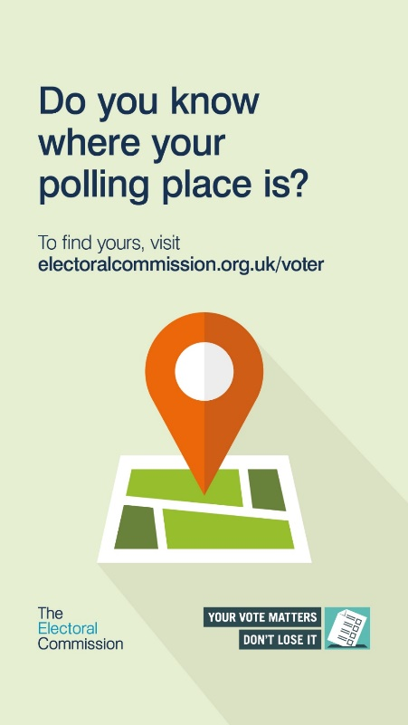
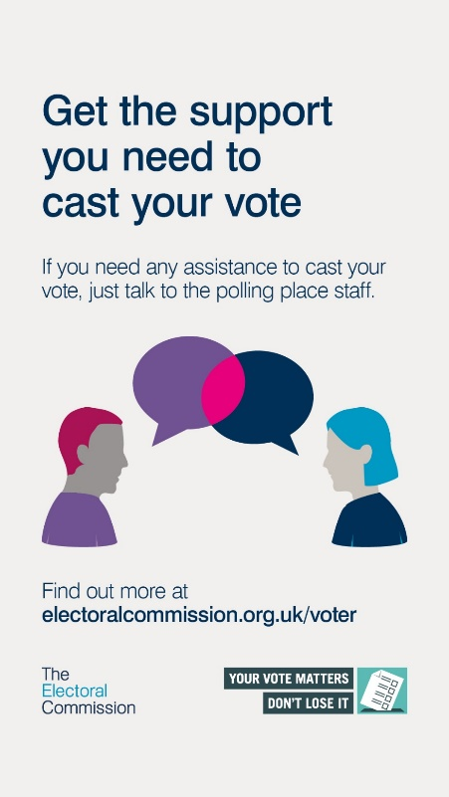
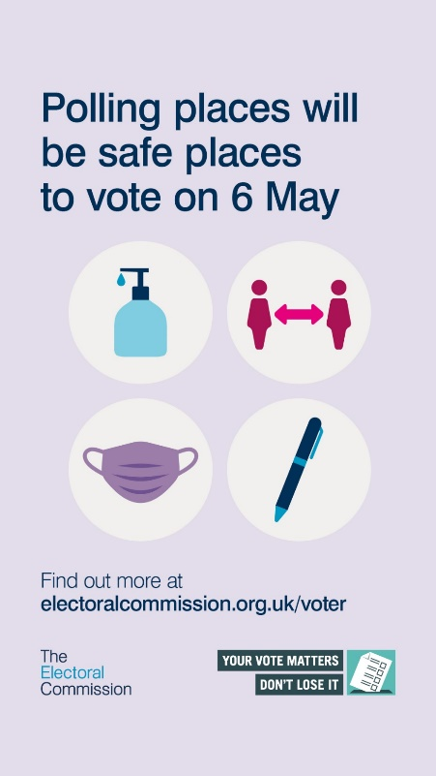
Voter information
STV animation
Paid for digital advertising
Stakeholder resources

Slide 9
Partnerships
Disability organisations
Education and youth partners
Consulates and other organisations who work with New Scots
Charities working with Black, Asian and Minority Ethnic communities
Homelessness charities
Domestic abuse charities

Slide 10
Partner resources and support
Voter information guide in various formats
Guide for blind and partially sighted voters
Guides for professionals working with prisoners, domestic abuse survivors and people without a settled address
FAQ for New Scots and guide for community group staff
10 March: Welcome to your vote awareness day to target foreign citizens
Events

Slide 11
How you can support the campaign
Share voter registration and information graphics and resources
Provide clear information at the polling place and in postal ballot packs
Share learning resources with schools and youth groups
Support Welcome to your vote day on 10 March
Work with local disability groups

Slide 12
Discussion Points
How can EROs and ROs work together to promote registration and turnout in your area?
Do you understand your own role in promoting the election and in assisting voters?
Are you aware of the range of materials available from the Electoral Commission to assist you?

