Slide 1
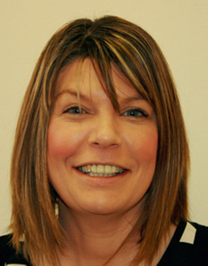
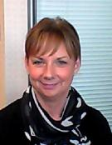
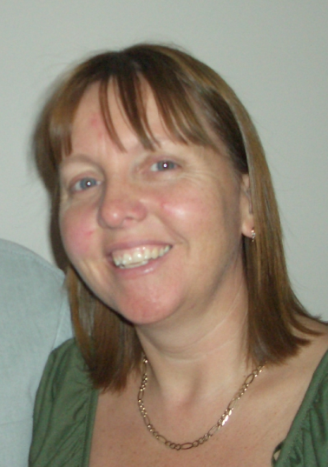
Forms Working Group – Who are we?
Catherine Johnstone
North Lanarkshire
Cheryl MacIver
Highland
Alison Johnson
Moray
Massimo Fabbreschi
City of Edinburgh
Scott Russell
City of Edinburgh
Aileen Knudsen
South Lanarkshire
Notes:
Forms Working Group – EMB Sub Group –
I intend to just take a few minutes to provide a quick update on the work of the Forms Working Group
Friendly bunch
Established in 2006
Sub Group of EMB
Mix of backgrounds
Between us we have XXX Years experience (Aileen 34; Cheryl 22; Catherine 16; Alison 11; Scott X; Massimo X) in 2016 (lost 30 years experience from John Bruce – thanks to John for his contribution over the years and Happy Retirement; also thanks to Liz Crawford who assisted in the past couple of years
Don’t claim to be experts but work hard, take our responsibility seriously, we do have some expertise in specific areas
Personally, find they are a great group to work with and ....
Keen to encourage involvement in the group

Slide 2
Forms Working Group
What do we do?
Meet about 1 or 2 occasions in the year but communicate by Email most of the time
Use Legislation and Guidance to produce forms and documents
Forms/Documents
Prescribed, Non-Statutory and Council
Compliment Electoral Commission suite of documents
Encourage consistency and sharing good practice
Notes:
Speak to slide

Slide 3
Forms Working Group
Where and When?
EC Forms – end February
http://www.electoralcommission.org.uk/i-am-a/electoral-administrator/local-council-elections-in-scotland-2017
FWG Forms – End January
http://www.electionsscotland.info/emb/site/index.php
Notes:
There will, as in the past, be an Index of forms detailing what the Forms Working Group have produced and what the EC have produced.
The FWG documents are in the same 5 categories as previous: Candidates/Agents; Poll; Postal Votes; Count and Back Office functions.
Encourage use and feedback on forms to allow a clearer

Slide 4
Forms Working Group
Feedback
Notes:
It would be useful, in light of the fact that there are currently no scheduled events for 2018, if you could provide feedback on the usefulness or otherwise of the various forms/documents after the LG Elections in May 2017. I will send a survey in due course for this purpose.

