Slide 1

Public Awareness
Sarah Mackie, Senior Officer - Communications

Slide 2
Campaign aim
Ensuring people know how to register to vote by the deadline of 17 April
Ensuring people know how to cast their vote including how to complete the ballot paper so their vote counts
Notes:
Aim: The campaign directs people to www.gov.uk/register-to-vote and our Freephone helpline (0800 3 280 280).

Slide 3
Creative
Updating and refreshing existing adverts
Adding new creative “local elections are happening on your doorstep’

Slide 4
Channels
Online display advertising
Paid for search's (Google)
TV / Online catch up (VOD)
Radio
Social media (featured adverts)
Press
Facebook messenger ‘bot’ trial
Household leaflet

Slide 5

Booklet
Voter information booklet to all households w/c 3 April:
  How to register
  How you can vote (including how to an apply for absent vote)
  How to complete the ballot paper
  Reminder that if you have received a poll card you are registered
Notes:
Pdf of different languages / alternative versions

Slide 6
Timings
Advertising will run in two phases:
  Phase one: voter registration focus up to 17 April
  Phase two: How to vote information up until polling day
20 Feb Social media advertising (testing)
6 March Digital advertising
14 March TV, radio, VOD
3 April Booklet delivery
18 April How to vote focus
Notes:
Paid for searches appear in the advertising space on google
TV: TV: ITV GB, C4, Five, Sky 30 Second ads individuals told they can’t do particular activities related to the inability to vote if you have not registered.
VOD: ITV, C4, Sky and YouTube
Household Leaflet 6 page role fold : sent to all households across Scotland providing further information on how to vote, sent to all households providing information on
Who can vote
How to vote
Filling in the ballot paper
Scottish Parliament

Slide 7
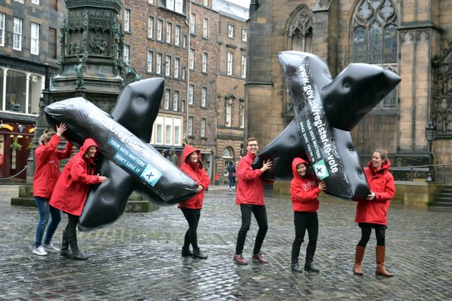
Partnerships with range of organisations
Local authorities / EROs
Youth
BME
Disability
Renters/movers/homeless
Voluntary sector
Social platforms
Notes:
Priority Audiences:
15-17 year olds/Students/Young people/Attainers
Young people in care
Homeless
People from black and minority ethnic communities
Disabled people
Service voters
Older people in care homes
Private and social renters
People who have recently moved house

Slide 8
Partnerships
Partner resources:
Partnership pack
Print ready posters
Website banners / buttons
Social media posts
Info graphics
Template press releases
Notes:
Partnership pack ready by 20 January
Posters – registration and ‘how to vote’

Slide 9
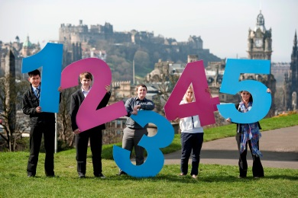
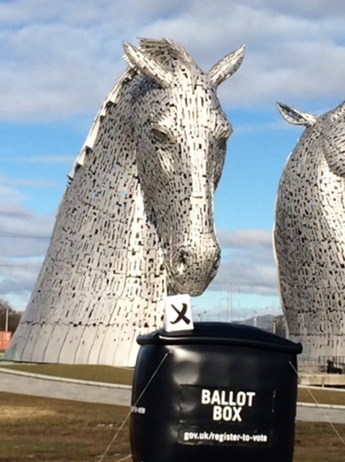

Partnerships - PR
Local media activity
  Commission PR props
  Template releases
‘#OnYourDoorStep’ campaign
  8 March (tbc)
  Promoting role of councils
Notes:
Joint work with councils
PR – template releases and use of props

Slide 10

15 - 17 year olds
#ReadyToVote
Encouraging schools and youth organisation to deliver a registration event on 1March 2016
Toolkit available by 20 January
  Includes FAQs, template articles/posts, lesson ideas
Delivered in partnership with councils, EROs, education and youth partners
Notes:
Last year 79% of schools took part
Toolkit will contain ( toolkit developed in consultation with partners)
How to run the event
Promoting the event using poster pdf, static images and copy for comms.
Registration walkthrough
Discussion points on Why Register?
FAQ’s to answer any question that may arise.

Slide 11
15 - 17 year olds
How you can help:
Encourage and support your schools to take part
Direct schools to download and share the toolkit: electoralcommission.org.uk (available from late January)
Publish content and images on your website, and in your newsletters, emails and online portals
Share content through your social media channels #ReadyToVote
Display and distribute posters

Slide 12
Sarah Mackie
Senior Officer - Communications
The Electoral Commission
Lothian Chambers,
59-63 George IV Bridge
Edinburgh EH1 1RN
Tel: 0131 225 0204
E-Mail: smackie@electoralcommission.org.uk www.electoralcommission.org.uk

