Slide 1
Electoral registration and delivering the Scottish local government elections 4 May 2017
Ian Milton
SAA Electoral Registration Committee

Slide 2
Key issues
Registers and election planning
15, 16 & 17 yr olds
Timeline
Absent votes

Slide 3
Registers and election planning
1 December 2016
Grampian LG electorate increased by 1% from 435k to 439k (1/12/15 reduced by 2%)
2016 canvass
Second full IER canvass
2 stage process - Stage 1 Household info/deletions/reviews
- Stage 2 Registration of new electors

Slide 4
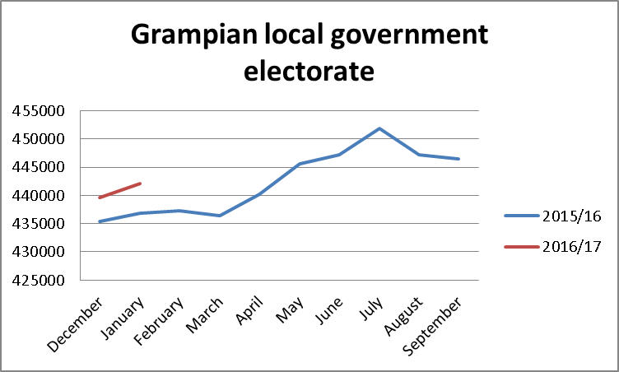
Registers and election planning - electorate

Slide 5
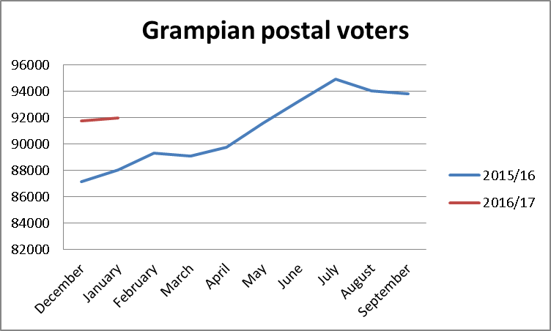
Registers and election planning – postal voters

Slide 6
15, 16 & 17 yr olds
Engagement, registration and verification
Election registers – no attainment age
Absent voter lists
Supply of registers

Slide 8
Timeline
EMB Convener Directions – consistency
All Scotland common deadline for first tranche of postal votes 29 March 2017 (SIENA registration application deadline).
All Scotland common date for second interim election notice of alteration (SIENA) – 7 April 2017 = E-17 EROs / E-16 ROs.
Easter Monday 17 April – final registration application deadline.
Wednesday 26 April – Final notice of alteration published – Registers finalised.

Slide 9
Absent votes
Postal – cancellation/amendment
Proxy – proxy appointments – must be registered
Emergency Proxy
Medical (disability)
AND
Occupation/Service/Employment
Rejected postal votes – data to ERO before sealing ready for 6 week chase up and canvass from 1 July

Slide 10
Questions?
Ian H Milton
Chairman SAA Electoral Registration Committee
Member of Electoral Management Board for Scotland
Grampian Assessor & Electoral Registration Officer
01224 664330 imilton@grampian-vjb.gov.uk

Slide 11
A few thoughts – reproduced by kind permission of the Private Eye magazine and David Ziggy Greene

