Slide 1
After the elections
Mary Pitcaithly & Chris Highcock – results returns
Andy O’Neill – reporting on the election

Slide 2
Results Returns
Why are we doing this?
Political Concern in 2012 – no central, official and consistent set of results
Resource for voters, elected members, journalists, academics
Accurate and consistent data set
Allow politicians to see “who won”…
Also in the interest of the voter

Slide 3
Data Collection
Direction No 9 “Provision of Information”
Full set of relevant data for all 354 contests
Two stage process:
  After close of nominations on 29 March 2017
  After completion of your count on 5 May 2017(as early as possible)

Slide 4
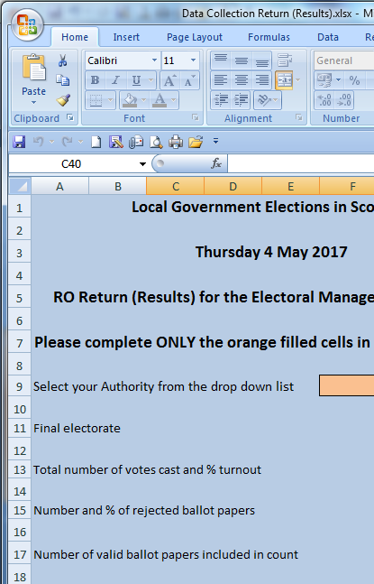
Results Returns
Excel spreadsheets
  With guidance notes
  Circulated 15/12/16
Limited information
Quick and simple
  minimise additional work

Slide 5
Data Collection – Pro-Formas
Pro-forma issued on 15 December 2016
A reminder and new copies will be issued in the new year.
  Copies in your delegate pack today.
“Road-tested” in recent by-elections and at the collation tests carried out in Pentland House

Slide 6
Data Collection - Nominations
Nominations
data on number of contests, electorate, candidates by number, gender and affiliation (party or independent)
Should be simple to gather from existing data sources
  Notice of Poll, Nomination papers, electorate statistics.

Slide 7
Data Collection - Results
Results
  Only sent after all wards within your council complete
Information on
  electorate, turnout, successful candidates by affiliation and gender, and first preference votes gained
All information - other than gender – is within standard eCount system reports

