Slide 1
Adjudication of Doubtful Votes
Mary Pitcaithly
Convener of the EMB
Returning Officer Falkirk Council

Slide 2
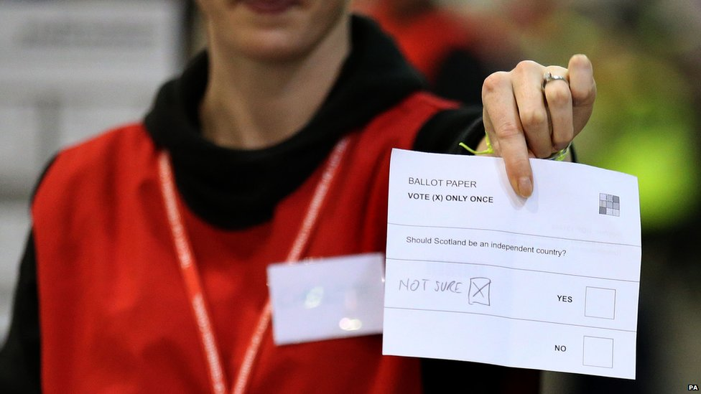
Adjudication of doubtful votes at the Scottish Local Government Elections 2017
Overview
Key Principles
STV and eCounting
Experience from recent by-elections
Notes:
Overview only - not going to play the “accept or reject” game
STV since 2007, plus by-elections, so principles should be well understood and accepted

Slide 3
Adjudication – Key Principles
Statutory function of RO (or delegated to DRO in writing)
Done in full view of candidates, their agents, Electoral Commission representatives and accredited observers
Must give reasons & consider views of those present
Can note “rejection objected to”
Decision of RO is final, subject only to review on election petition…i.e. it is a “quasi-judicial determination”

Slide 4
Principles
The discretion of RO limited to rejecting votes solely on the grounds listed in the local government election rules
Election Rules – 5 grounds for rejection
Does not bear a unique identifying mark in a form that is capable of being read by electronic means
A number standing alone is not placed so as to indicate a first preference for some candidate
The figure “1” standing alone indicating a first preference is set opposite the name of more than one candidate
Writing or mark by which the voter can be identified except the printed number and other unique identifying mark on the back
Unmarked or void for uncertainty

Slide 5
STV & eCounting
Minimising need for adjudication starts at polling and before
“use numbers”
do all you can to help voters to follow the instructions
Information for voters
Principles, approach, preparation same as for any other election
Confidence
Consistency
Communication
Consistency in the classification of rejections
This will be collated after the election

Slide 6
Adjudication In Practice
Promoting confidence in the results!
General approach:
Confidence
Consistency : within your count and across Scotland
Communication
Give a considered decision in each case
Think about how you would justify if challenged
Narrate your logic
Attempt to allow, not reject
Discern voter’s intention and give effect to it
Allow where voter’s intention is reasonably clear

Slide 7
Adjudication who does it?
Can be formally delegated to DRO(s)
Skills needed –
Understanding of principles
Integrity
Impartiality
Experience of dealing with politicians
Consistency of approach
Leads to confidence of candidates , agents and observers in process – fundamental objective

Slide 8
Preparation
Get familiar with Placemats and Booklet
Have them available in count centre
Think about previous experience
See how the principles of adjudication are applied in practice
Ultimately it is the principle that matters
Understand decisions on the examples in the guidance / placemat
If challenged, be ready to refer to examples to support your decision

Slide 9
Experience from recent by-elections
Adjudication rates
Have been improving due to better scanning technology
Now often around 16%, previously over 28%
Adjudication vs RO Adjudication
Papers sometimes deferred to the RO that could readily have been accepted earlier delays the count . Accept as many as possible at the first stage
EMB may provide additional guidance in coming months
Consistency needed with respect to “1st pref vote not clearly to one candidate” vs “1st pref vote for more than one candidate”
Only use the latter where there are clearly multiple Xs, 1s, “Yes”, ✓ or other “first preference” marks

Slide 10
Experience from recent by-elections
Retrieval of blank papers
Be aware that RO may have to retrieve blank papers to inspect
Note that some colours of pen do not scan well or at all
#usepencils ;-)

Slide 11
The “controversial one”
The “controversial one”
“a 2 in the second box but nothing else” etc should no longer be controversial
It is rejected, no clear first preference

Slide 12
Adjudication
Any Questions?

