Slide 1

Electoral Management Board for Scotland
Principles and process of signature comparison and verification
Presented by: Gail McKay
07 April 2026

Slide 2
Fundamental principles
1. The writing and signature of an individual cannot necessarily be connected

Slide 3
Fundamental principles
1. The writing and signature of an individual cannot necessarily be connected
2. The signature of one individual has a natural variation

Slide 4
Fundamental principles
1. The writing and signature of an individual cannot necessarily be connected
2. The signature of one individual has a natural variation
3. The signature of one individual has a range of variation that cannot be determined from one control signature

Slide 5
Fundamental principles
1. The writing and signature of an individual cannot necessarily be connected
2. The signature of one individual has a natural variation
3. The signature of one individual has a range of variation that cannot be determined from one control signature
4. Co-incidental matches are uncommon

Slide 6
Fundamental principles
1. The writing and signature of an individual cannot necessarily be connected
2. The signature of one individual has a natural variation
3. The signature of one individual has a range of variation that cannot be determined from one control signature
4. Co-incidental matches are uncommon
5. Signatures must be similar to be accepted

Slide 7
Fundamental principles
1. The writing and signature of an individual cannot necessarily be connected
2. The signature of one individual has a natural variation
3. The signature of one individual has a range of variation that cannot be determined from one control signature
4. Co-incidental matches are uncommon
5. Signatures must be similar to be accepted
6. A successful forger has to reproduce the shape and fluency of a signature

Slide 8
Fundamental principles
1. The writing and signature of an individual cannot necessarily be connected
2. The signature of one individual has a natural variation
3. The signature of one individual has a range of variation that cannot be determined from one control signature
4. Co-incidental matches are uncommon
5. Signatures must be similar to be accepted
6. A successful forger has to reproduce the shape and fluency of a signature
7. Genuine signatures usually have the same pen path

Slide 9
Fundamental principles
1. The writing and signature of an individual cannot necessarily be connected
2. The signature of one individual has a natural variation
3. The signature of one individual has a range of variation that cannot be determined from one control signature
4. Co-incidental matches are uncommon
5. Signatures must be similar to be accepted
6. A successful forger has to reproduce the shape and fluency of a signature
7. Genuine signatures usually have the same pen path
8. Genuine signatures are usually similar in fluency

Slide 10
Fundamental principles
1. The writing and signature of an individual cannot necessarily be connected
2. The signature of one individual has a natural variation
3. The signature of one individual has a range of variation that cannot be determined from one control signature
4. Co-incidental matches are uncommon
5. Signatures must be similar to be accepted
6. A successful forger has to reproduce the shape and fluency of a signature
7. Genuine signatures usually have the same pen path
8. Genuine signatures are usually similar in fluency

Slide 11
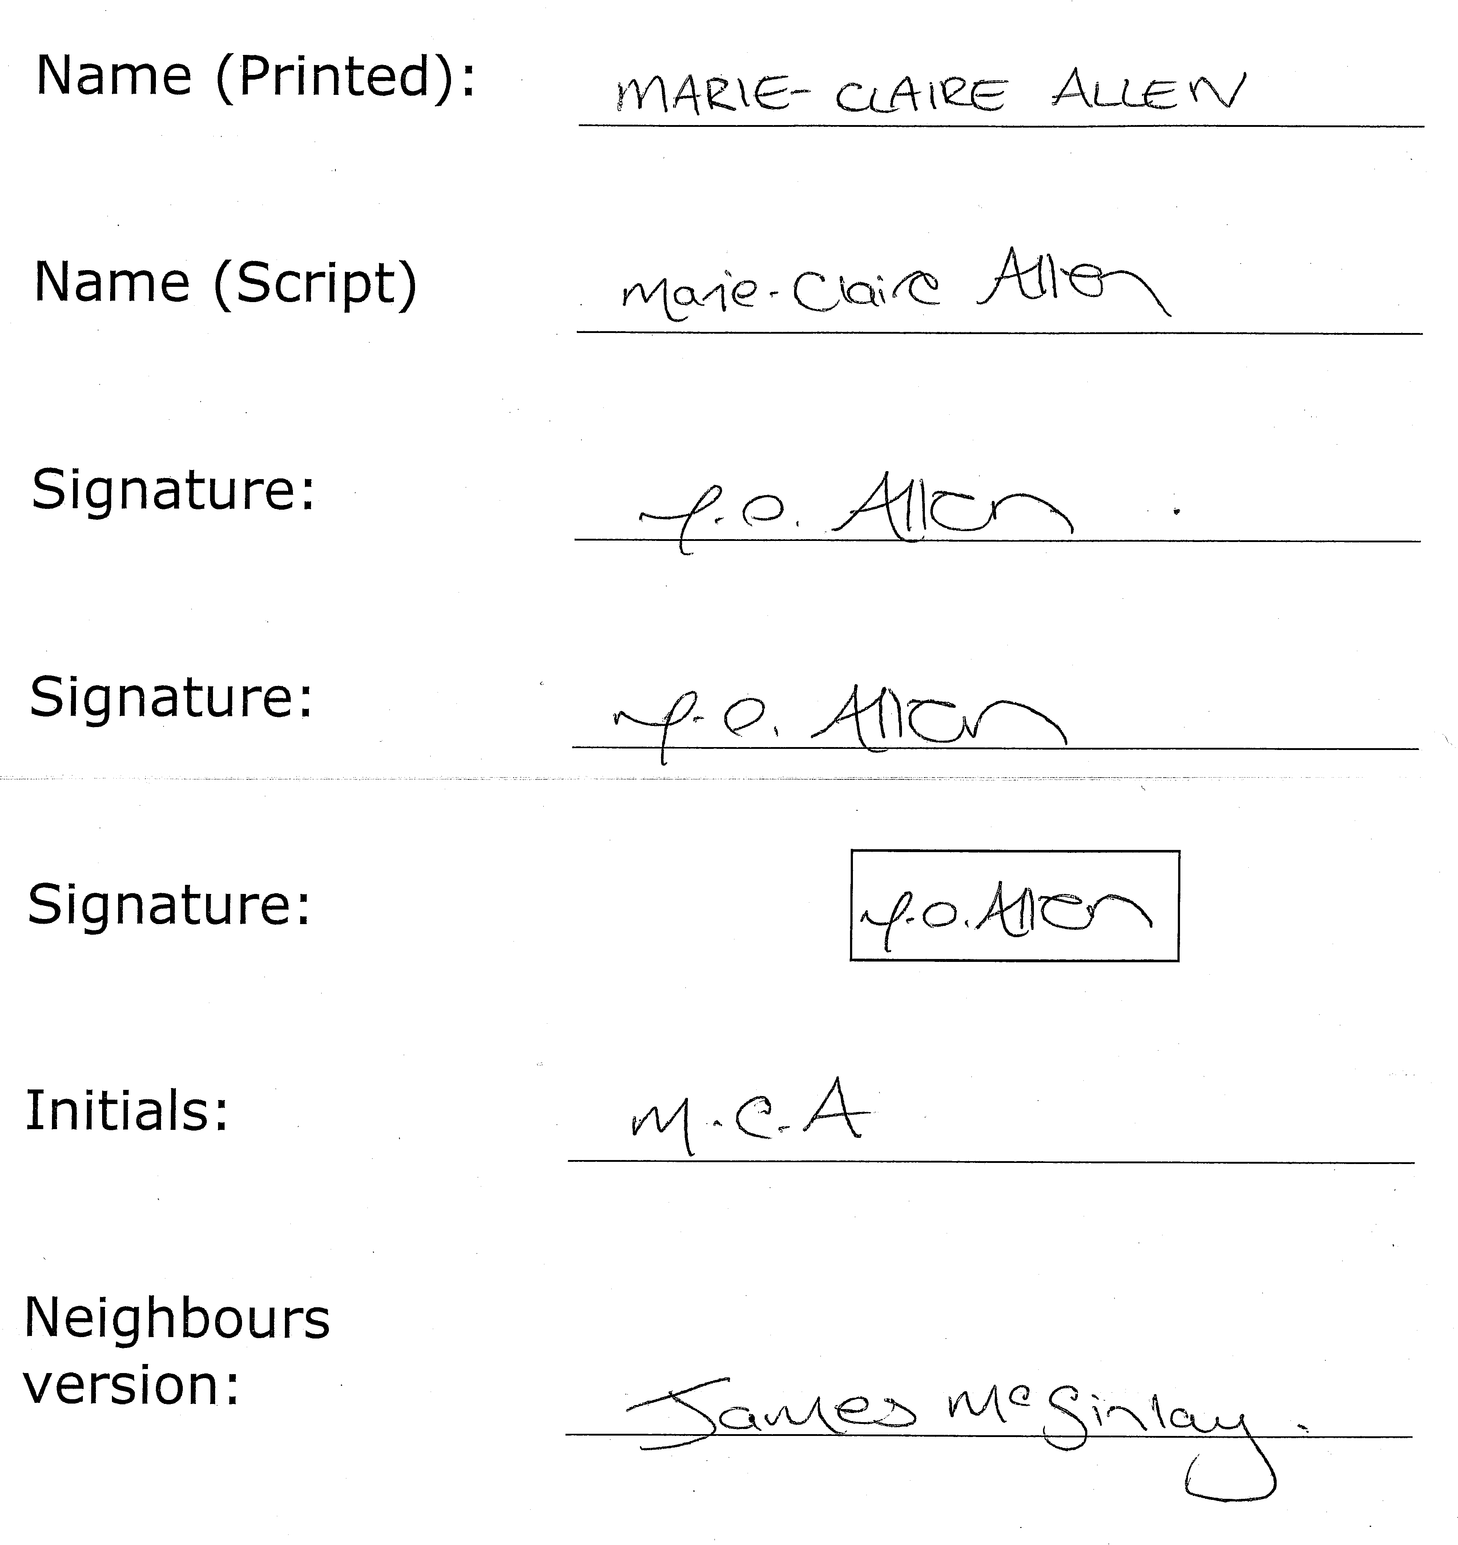
Samples

Slide 12
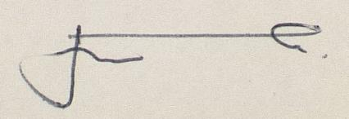
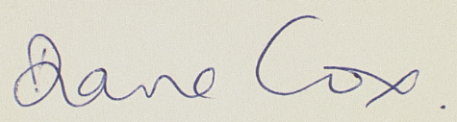
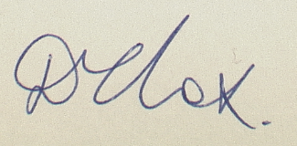
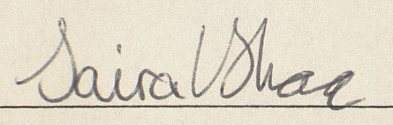
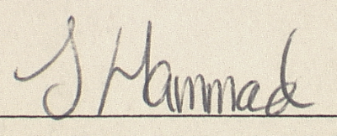
Principle 1. Comparing like with like
Many signatures are stylised, and bear little resemblance to the normal handwriting style of the author.
Individuals may have two styles of signature, a full signature and a shorter version (including initials)
Change of circumstances

Slide 13
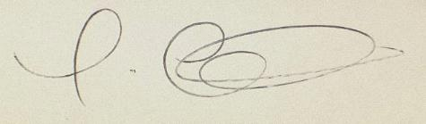
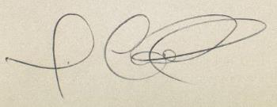
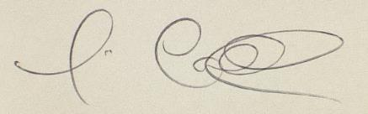
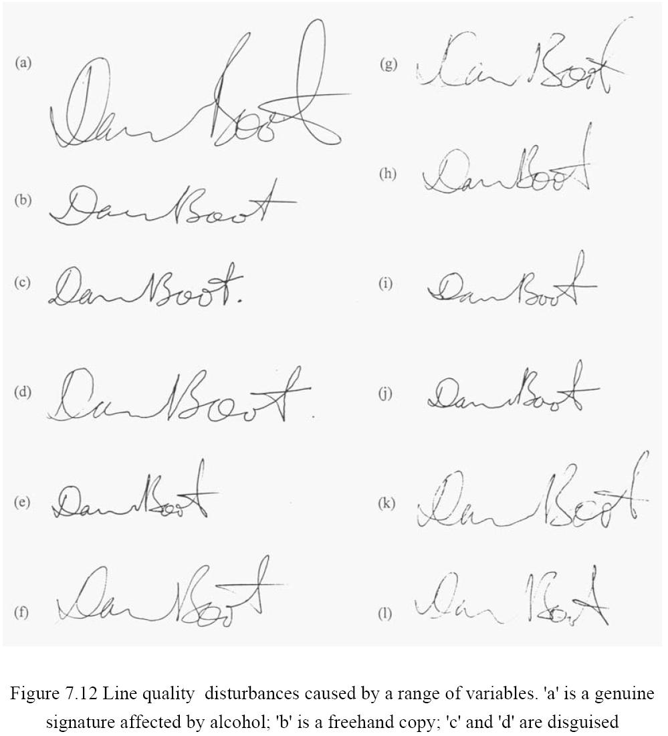
Principle 2. Natural variation
Individuals are not machines, and whilst signatures are developed into a style over time, the signatures of an individual will vary.
External factors, such as temperature, type of writing implement, surface and health, can affect a signature.
Alcohol

Slide 14
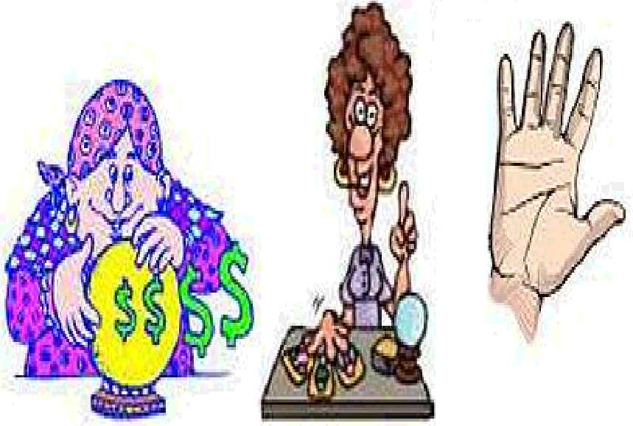
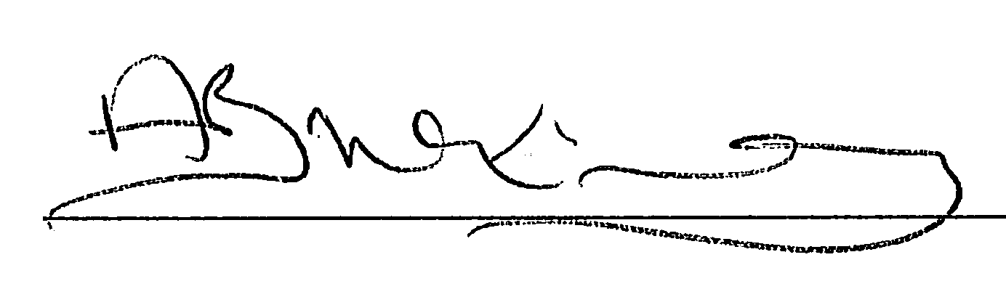
Principle 3. Lack of variation
Whilst individuals have a variation, based on a single example it is impossible to assess this range. Assume the worse and accept that the individual may have a large range of variation in their signature.

Slide 15
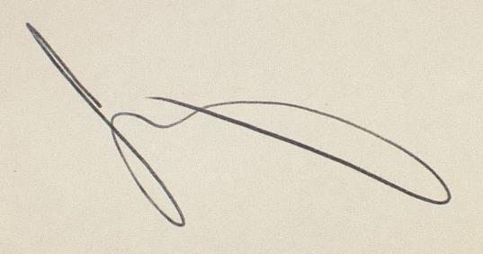
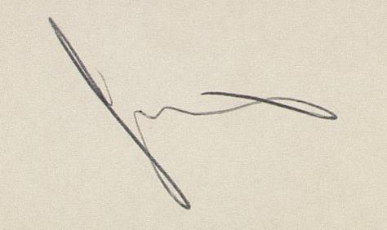
Principle 4. Co-incidental match
Signatures vary in complexity. Simple signatures are more prone to chance resemblance than complex signatures, but the likelihood of chance resemblance is remote.
James McGinlay
Jacqueline Morris

Slide 16
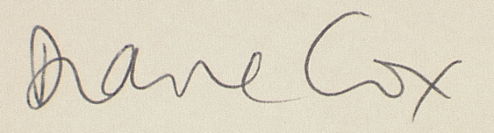
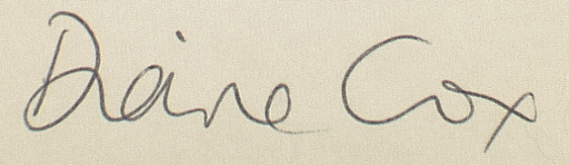
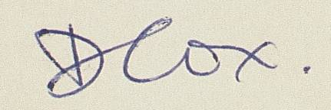
Principle 5. Pictorial similarity
Signatures are a form of personal identification (along with fingerprints and DNA). For acceptance of common authorship the signatures must look similar.
Occasionally parts of signatures differ (for example differing forenames). It may be that portions of the signature are comparable and relevant features should be examined.

Slide 17
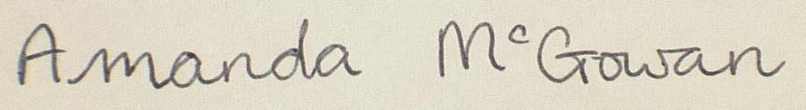
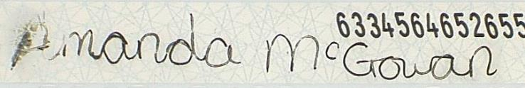
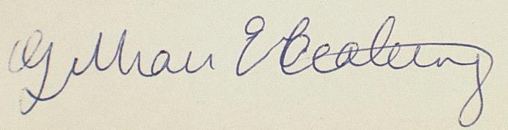
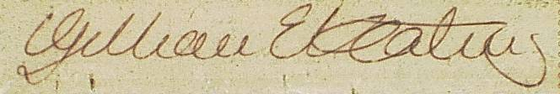
Principle 6. Successful forgeries
Experience has shown that forgers tend to try and reproduce shape at the expense of fluency. With simple signatures it is difficult to differentiate a good simulation from a genuine signature.
Simulation becomes more difficult as the signature becomes more complex and it is difficult for the forger to get both shape and fluency correct.

Slide 18
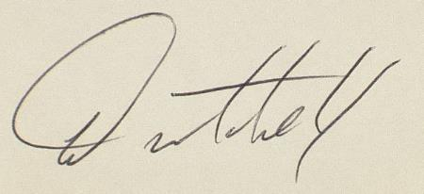
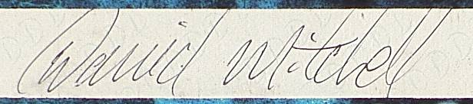
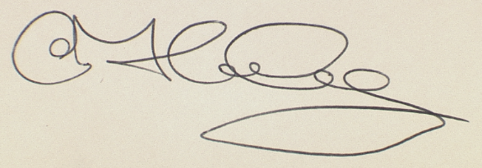
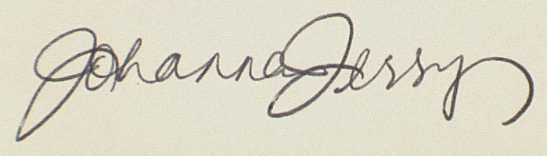
Principle 7. Pen path
A complex, fluent signature with the same pen path is almost certainly by the same author.

Slide 19
Principle 8. Fluency
A complex, fluent signature with the same pen path is almost certainly by the same author.

Slide 20
Yes
Yes
Accept
W
Are both signatures low in fluency?
No
Are there fluent parts which are similar?
No
D
Reject
Rejected by machine
Reject
A
Fluency
No
No
Is signature in same shape?
Yes
Is signature in same name?
Yes
Are signature pen paths similar?
No
B
Yes
Structure
Visual check only
Reject
Complexity/ Shape
Are signatures similar in fluency?
Yes
X
Accept
No
Fluency
Electoral Commission Process
Which signature is not fluent?
Control
Accept
Y
Fluency
Poll
Fluency
Are signatures similar fluency in parts?
Yes
Are signatures similar in the fluent parts?
Yes
Accept
Z
No
Reject
C
No

Slide 21
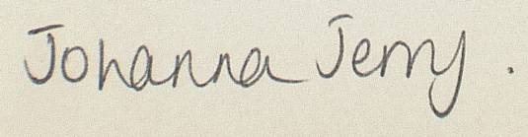
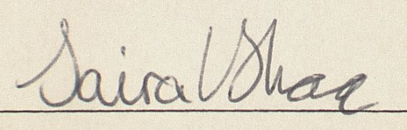
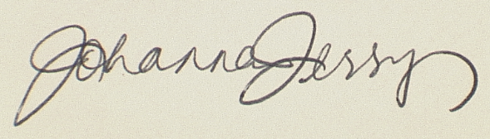
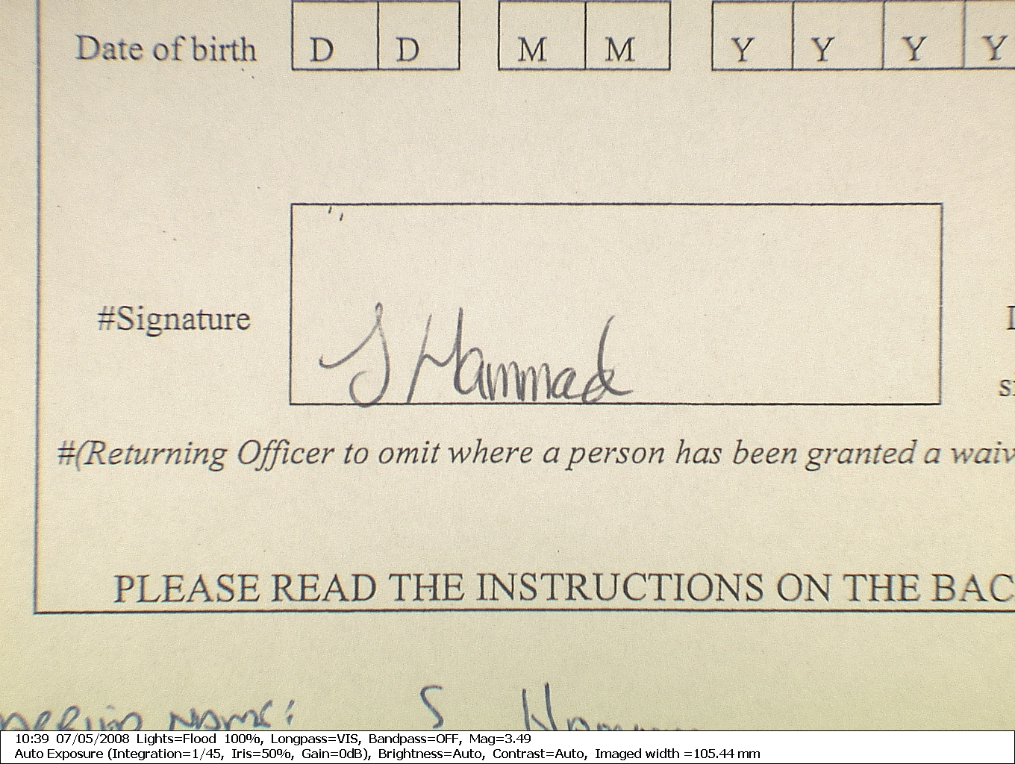
Initial stages - “Complexity“ [Shape]
Is the signature in the same shape?
Yes
Is the signature in the same name?
Yes
No
No
Reject
A
Reject
B

Slide 22
Yes
Yes
Accept
W
Are both signatures low in fluency?
No
Are there fluent parts which are similar?
No
D
Reject
Rejected by machine
Reject
A
Fluency
No
No
Is signature in same shape?
Yes
Is signature in same name?
Yes
Are signature pen paths similar?
No
B
Yes
Structure
Visual check only
Reject
Complexity/ Shape
Are signatures similar in fluency?
Yes
X
Accept
No
Fluency
Electoral Commission Process
Which signature is not fluent?
Control
Accept
Y
Fluency
Poll
Fluency
Are signatures similar fluency in parts?
Yes
Are signatures similar in the fluent parts?
Yes
Accept
Z
No
Reject
C
No

Slide 23
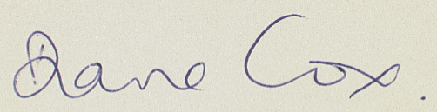

Initial stages - “Structure“ [Pen paths]
From complexity stage
Are both signatures low in fluency?
No
Are the signature pen paths similar?
Yes
Are the signatures similar in fluency?

Slide 24
Yes
Yes
Accept
W
Are both signatures low in fluency?
No
Are there fluent parts which are similar?
No
D
Reject
Rejected by machine
Reject
A
Fluency
No
No
Is signature in same shape?
Yes
Is signature in same name?
Yes
Are signature pen paths similar?
No
B
Yes
Structure
Visual check only
Reject
Complexity/ Shape
Are signatures similar in fluency?
Yes
X
Accept
No
Fluency
Electoral Commission Process
Which signature is not fluent?
Control
Accept
Y
Fluency
Poll
Fluency
Are signatures similar fluency in parts?
Yes
Are signatures similar in the fluent parts?
Yes
Accept
Z
No
Reject
C
No

Slide 25
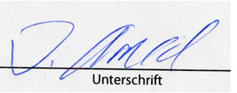
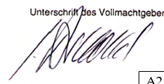
Initial stages - “Fluency “
Yes
Yes
Accept
W
Are both signatures low in fluency?
Are there fluent parts which are similar in both signatures
From structure stage
No
No
Reject
D

Slide 26
Yes
Yes
Accept
W
Are both signatures low in fluency?
No
Are there fluent parts which are similar?
No
D
Reject
Rejected by machine
Reject
A
Fluency
No
No
Is signature in same shape?
Yes
Is signature in same name?
Yes
Are signature pen paths similar?
No
B
Yes
Structure
Visual check only
Reject
Complexity/ Shape
Are signatures similar in fluency?
Yes
X
Accept
No
Fluency
Electoral Commission Process
Which signature is not fluent?
Control
Accept
Y
Fluency
Poll
Fluency
Are signatures similar fluency in parts?
Yes
Are signatures similar in the fluent parts?
Yes
Accept
Z
No
Reject
C
No

Slide 27
Initial stages - “Structure“
From complexity stage
Are both signatures low in fluency?
No
Are the signature pen paths similar?
Yes
Are the signatures similar in fluency?
Yes
Accept
X
No

Slide 28
Yes
Yes
Accept
W
Are both signatures low in fluency?
No
Are there fluent parts which are similar?
No
D
Reject
Rejected by machine
Reject
A
Fluency
No
No
Is signature in same shape?
Yes
Is signature in same name?
Yes
Are signature pen paths similar?
No
B
Yes
Structure
Visual check only
Reject
Complexity/ Shape
Are signatures similar in fluency?
Yes
X
Accept
No
Fluency
Electoral Commission Process
Which signature is not fluent?
Control
Accept
Y
Fluency
Poll
Fluency
Are signatures similar fluency in parts?
Yes
Are signatures similar in the fluent parts?
Yes
Accept
Z
No
Reject
C
No

Slide 29
Initial stages - “Fluency “
Accept
X
Yes
From fluency stage
Are both signatures similar in fluency?
No
Which signature is not fluent?
Control
Accept
Y
Control
Poll
Poll

Slide 30
Yes
Yes
Accept
W
Are both signatures low in fluency?
No
Are there fluent parts which are similar?
No
D
Reject
Rejected by machine
Reject
A
Fluency
No
No
Is signature in same shape?
Yes
Is signature in same name?
Yes
Are signature pen paths similar?
No
B
Yes
Structure
Visual check only
Reject
Complexity/ Shape
Are signatures similar in fluency?
Yes
X
Accept
No
Fluency
Electoral Commission Process
Which signature is not fluent?
Control
Accept
Y
Fluency
Poll
Fluency
Are signatures similar fluency in parts?
Yes
Are signatures similar in the fluent parts?
Yes
Accept
Z
No
Reject
C
No

Slide 31
Initial stages - “Similarities in Fluency “
No
Reject
C
From fluency stage
Are both signatures similar in fluency in the same parts?
Is the pen path similar in the fluent parts?
Yes
Yes
Accept
Z
Poll – not fluent
Poll
Control

Slide 32
Yes
Yes
Accept
W
Are both signatures low in fluency?
No
Are there fluent parts which are similar?
No
D
Reject
Rejected by machine
Reject
A
Fluency
No
No
Is signature in same shape?
Yes
Is signature in same name?
Yes
Are signature pen paths similar?
No
B
Yes
Structure
Visual check only
Reject
Complexity/ Shape
Are signatures similar in fluency?
Yes
X
Accept
No
Fluency
Electoral Commission Process
Which signature is not fluent?
Control
Accept
Y
Fluency
Poll
Fluency
Are signatures similar fluency in parts?
Yes
Are signatures similar in the fluent parts?
Yes
Accept
Z
No
Reject
C
No

Slide 33
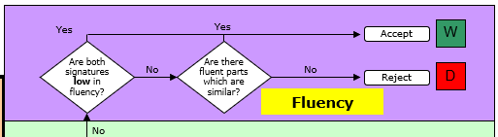
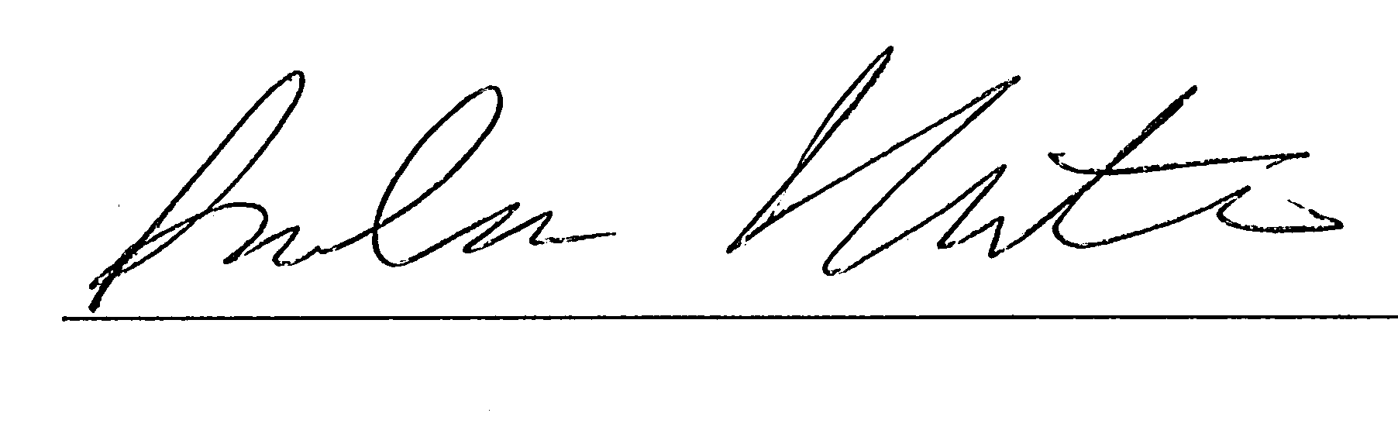
Both control and poll are fluent but different in pen paths Reject at Point D
Examples
Control
Poll

Slide 34
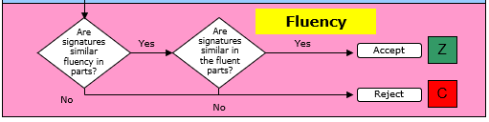
The control is fluent while the poll lacks fluency throughout. Reject at Point C
Examples
Control
Poll

Slide 35
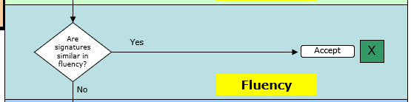
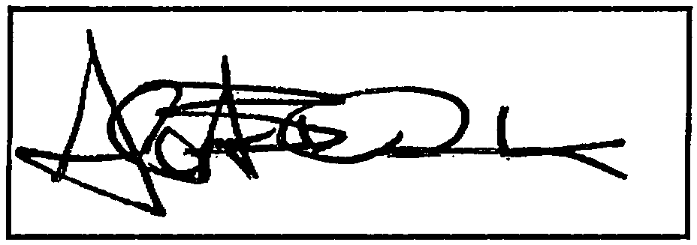
Both control and poll are fluent with similar pen paths – Accept at Point X
Examples
Control
Poll

Slide 36
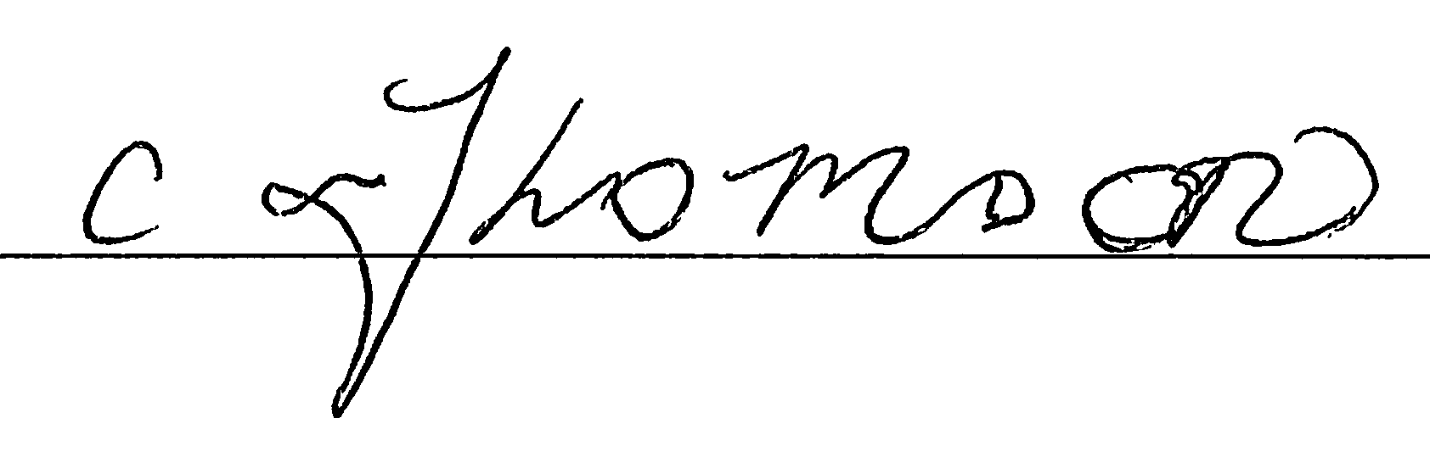
The control is fluent while the poll lacks fluency throughout. Reject at Point C
Examples
Control
Poll

Slide 37
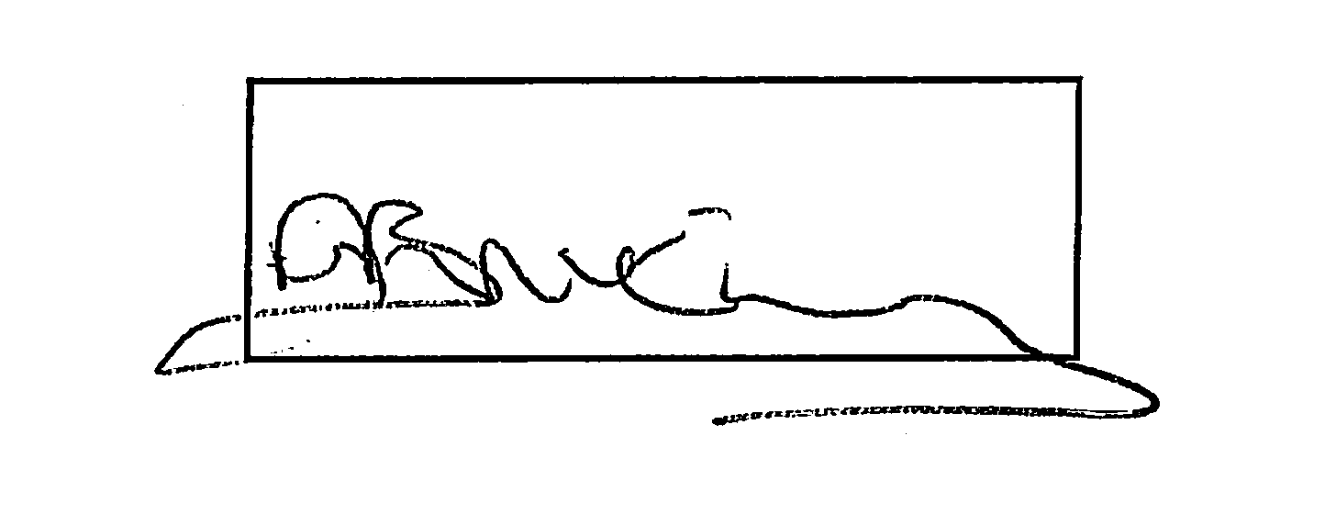
Both control and poll are fluent with similar pen paths – Accept at Point X
Examples
Control
Poll

Slide 38
Summary
The examiner is looking for large differences in:
Shape
Pen-path
Fluency
Remember:
If there are no large differences, the likelihood is that the signature is genuine.

Slide 39
QUESTIONS?

