Slide 1
Good Practice in Manual Verification and Count
An Electoral Management Board Seminar
25 September 2026

Slide 2
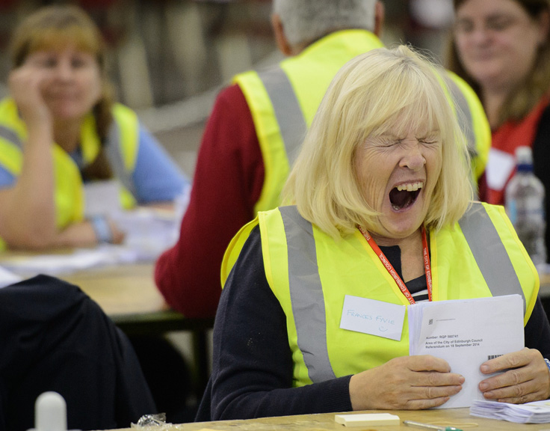
Background – why are we doing this?
Request from RO Members of the EMB for a “Good Practice Review” of Manual Verification and Count
Operations can be isolated – often little opportunity to observe and learn from others
Issues at some recent events
Scottish Parliament Count more complex than any other
Notes:
Guiding Principles —
https://aceproject.org/main/english/vc/vc10.htm

Slide 3
Background – different models
To produce a result in which all stakeholders can have full confidence
Counts for UK / Scottish Parliaments are undertaken manually. Returning Officers may also count council by-elections manually.
Some elements of the verification/count process are legislatively prescribed, others are determined locally.
Count models vary between councils, with different degrees of traceability and control.
Generally, Election Teams have inherited a count model from previous incumbents

Slide 4
Background – scrutiny
There may be reluctance to change the model for fear of loss of control or potential confusion of staff.
Counts have become more complex with the addition of large volumes of postal votes, some of which are introduced late in the count process (not a problem with next day count)
Counts are subject to high levels of scrutiny from candidates / media.
Delay to count completion, or failure to reconcile figures can erode confidence in the count process, final result acceptance and impact the RO / Council reputation
A transparent count, with clear audit trails and lines of control is essential to uphold confidence.
To produce a result in which all stakeholders can have full confidence
Notes:
Secrecy
Secrecy of the vote is important because it ensures that voters cannot be punished for the way they vote, or intimidated into voting a particular way. To preserve the secrecy of the vote, voters' identification must be protected during the count. If their identity and choice on the ballot is determined as a result of counting procedures, it must be kept confidential and never revealed. If the secrecy of the vote of individuals or a community is a concern, measures such as counting at counting centres, rather than at individual polling stations, or mixing ballots from different polls, can be considered. Numbered ballot papers corresponding to matching stubs with the voter details, while facilitating accountability and clear audit trails, compromise secrecy and are best avoided

Slide 5
Processes are Transparent
Verification produces an accurate result
Each count produces an accurate result
Results are timely
Secrecy of the vote is maintained at all times
Security of ballot papers and other stationery is maintained at all times
Communication of information is clear and timely
Notes:
Principles of an effective verification and count | Electoral Commission

Slide 6
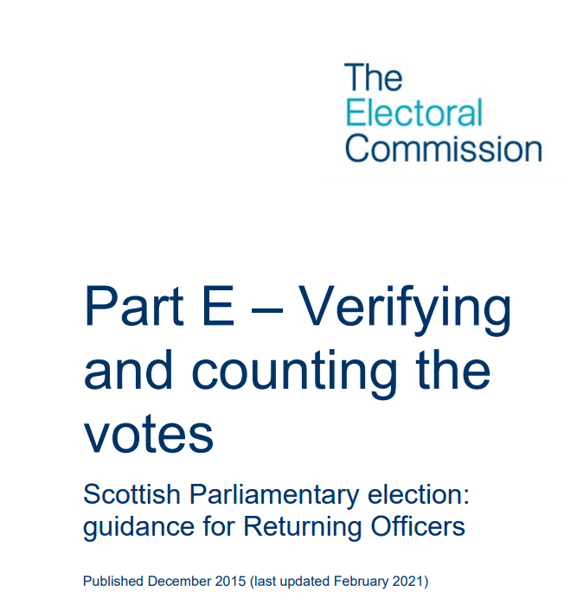
Resources
Post-election reviews / Lessons Learned
Legislation
Electoral Commission Guidance
Sample spreadsheets, documentation, layouts etc can all be shared.

Slide 7
Principles
Build and uphold confidence
Maintain accuracy and compliance
Communication, transparency and trust
Clear audit trail demonstrating decision making / traceability
Maintaining security and integrity
Speed, consistency and capability
Resilience
Minimise any justification for calls for a recount
What is this all about?
Notes:
Transparency
For the counting process to be open and transparent, representatives of political parties and candidates should be allowed to witness and/or participate in the process, and permitted to copy the statement of the results of the counting process. National and international electoral observers should also be allowed to witness the process and permitted to copy the statement of the results of the counting process. In some countries, ordinary citizens are encouraged to watch the counting process.
Manual counting is by its nature more transparent than computerized counting. If vote counting is computerized, new mechanisms for ensuring transparency, such as external audits, need to be introduced.

Slide 8
Accuracy
Speed
Accuracy is more important than speed….within reason!
Notes:
Accuracy
Accuracy is directly related to the integrity of the count, and of the elections themselves. Later discovery of errors and correction of mistakes can lead to accusations of manipulation or fraud. The accuracy of the count will depend on clear procedures and manuals, adequate staff training, and their commitment to the process. Clear audit trails of ballots and ballot boxes, as well as checking and rechecking mechanisms, will contribute to the accuracy of the results. Whilst mechanical voting or computerization may enhance accuracy, this must be balanced against the resulting apparent loss of transparency.
.
Timeliness
Delays in completing the count and in the release of unofficial preliminary results can negatively affect the level of integrity and confidence in the voting process. The responsible electoral management body should carefully plan all stages of the counting process to facilitate the early announcement of results, or at least to realistically assess when results can be announced, taking into consideration the communications and transport infrastructure.

Slide 9
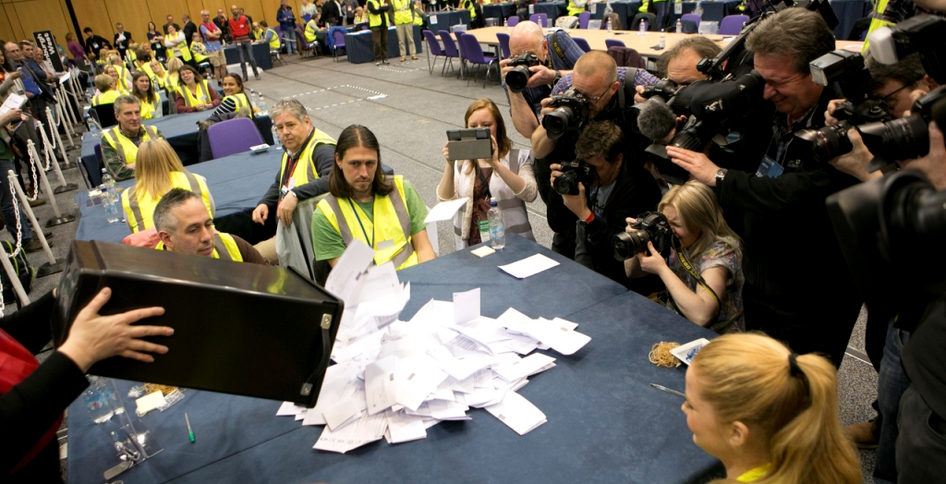
Key areas to plan
Model
Mechanics
Management
Recounts
Documentation
Logistics/Layout
Information sharing
Infrastructure
Regional Count
Managing Media

Slide 10
Model mini-count vs ‘traditional’
Mechanics how we physically count the papers
Management Staffing/Governance/ Control – oversight and escalation of issues
Documentation slips, forms and spreadsheets
Logistics and Layout how to manage space and flow of paper /kit / staff / stakeholders
Information sharing full verification, sampling, data, etc.
Infrastructure media/ communications/ public safety/passes/requirement for secrecy etc.
Recount – why and how …why not
The Regional Count - considerations

Slide 11
Model
Mini-count is preferred
Audit trails
Traceability
Accuracy
New – to some so may be unwilling to adopt
Slightly slower?
New layouts, spreadsheets
Unfamiliar to candidates and agents
Mini-count vs “traditional”
Notes:
sample-mini-count-model
The advice in this part of the guidance is predicated on the assumption that Counting Officers will operate a mini-count model. The key feature of the mini-count is that votes do not move once allocated to a count table, thereby facilitating the identification and resolution of any discrepancy which may arise during the count process. It should be used for this purpose and not to produce results for small identifiable areas.
2014 Referendum Guidance https://www.emb.scot/downloads/file/107/part-e-verification-and-count

Slide 12
Mechanics
Papers only on tables or in the box….
Keep agents at distance, only talk via supervisor
Written instructions / training / briefing
Transparency – face up, which box etc
Speed – 25s, 50s, etc
Check and double check
Equipment – fingerettes, post its, bands, clips
Manage staff – shuffle, reallocate
Physically counting papers
Notes:
2014 Referendum Guidance remains very good on the process…
Or EC Guidance Guidance for Returning Officers administering a Scottish Parliament election | Electoral Commission

Slide 13
Management
Training staff
          Role specific training
Clear understanding of roles
Chain of command
Who engages with observers, candidates, agents
Managing poor performance – intervene and move
Tolerance levels +/- explain discrepancies – you can only count what is in the box….
Water only / food / bags & coats / High Vis ?
Contingency Plans…. Including next day recount….
Oversight and escalation

Slide 14
Recount
Try to minimise through briefing, transparent processes and early intervention – “why didn’t you tell me 2 hours ago!”
Only a candidate or an election agent can request a recount/ further recount. They must be present at the count to make a request.
A decision of the Returning Officer – “the CRO may refuse to do so if in the CRO’s opinion the request is unreasonable”
What is reasonable? Close result? / Danger of losing deposit?/ Minor process issue?
Bundle Check… Full recount should be very unusual
Constituency vs Region
Why and How

Slide 15
Documentation
Internal & external
Dependent on count model
Preparation ahead of count / testing
Spreadsheets / report slips
Proof check – do all the columns add up etc
What is shared with candidates and agents: Turnout, totals, declarations
What is provided to media

Slide 16
Logistics and Layout
Efficient count starts at polling – accurate ballot paper account, unused papers etc
Minimising movement / double handling
“Boxes in” / receiving : marked registers, CNLs, BPAs
Checking of unused….
Process is the priority – NOT media or candidates
Scrutiny vs Secrecy
Health and Safety
Stage/Media etc
Contingency planning – evacuation plan etc
Efficiency & Transparency

Slide 17
Information Sharing
Starts before the count – candidates and agents know what to expect, layout, process, standards of behaviour, requirement for secrecy
Explaining the process
What must be made available to candidates and agents – verification (turnout etc); when?
Scrutiny not sampling…. but
Sampling – information on which box is being verified
Adjudication, declarations, results
Scrutiny, transparency, communication

Slide 18
Infrastructure
Public Safety / security – passes, security
Security – major concern in 2026; local circumstances
Police, First Aid
Public announcements
Comms support – posting the results
Media engagement
Dealing with the aftermath: counted papers, marked registers, CNLs, etc

Slide 19
Regional Count
Total across Region not in any one count
Parallel or Series….rummage?
Size of paper – difficult to handle
Any problems with constituency results will delay Regional seat allocation
Fewer observers/agents – likely to be at RRO Count
Reallocation of staff as needed
Dry run – practice process for passing on totals; cyber security

Slide 20
Managing Media
Estimated declaration times?!
Nominate a single media liaison manager
Media accreditation
Decide early what information you will make available on the night and how you’ll share this – hard copies; X?
Make contact on the night
Communicate any changed plans
Given notice of any announcements
Audience is beyond the hall….
Communicate
Results
Generate confidence
Reputation

